Slide 1


How To Automate Everything With Azure DevOps
Robby Millsap
@robbymillsap
https://www.linkedin.com/learning/instructors/robby-millsap
Notes:
When they asked if I would speak...
My name is Robby Millsap, but you can call me sap...

Slide 2
What mundane, daily task would you automate if you could?
Notes:
Let’s do an exercise...

Slide 3
How To Automate Everything With Azure DevOps
BE SUPER LAZY
Robby Millsap
@robbymillsap
https://www.linkedin.com/learning/instructors/robby-millsap
Notes:
When they asked if I would speak...
My name is Robby Millsap, but you can call me sap...

Slide 4
Survey – show of hands
Popcorn – shout it out
@robbymillsap
Notes:
A lot of people never know

Slide 5
My pledge
@robbymillsap

Slide 6
I will never read bullets directly from my slides.
I will never use bulleted lists
I often speak too fast (it’s a problem)
@robbymillsap
Notes:
I pledge

Slide 7
Question
@robbymillsap
Notes:
Who here is currently using Azure DevOps in production?
Who is using another CI/CD tool?

Slide 8
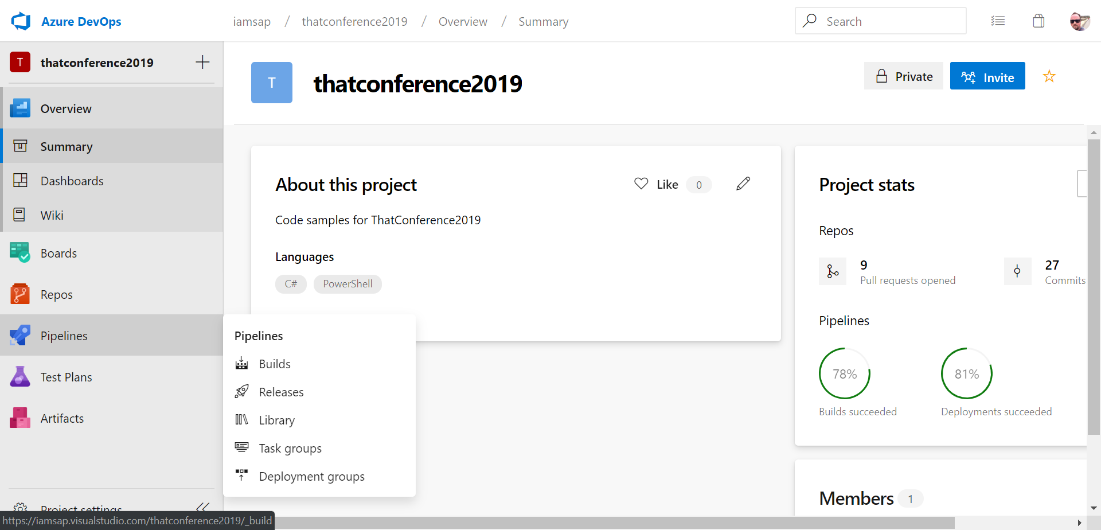
@robbymillsap
Notes:
This is the layout of Azure DevOps
Repos is our GIT repo
Pipelines contain our BUILDS and RELEASES

Slide 9
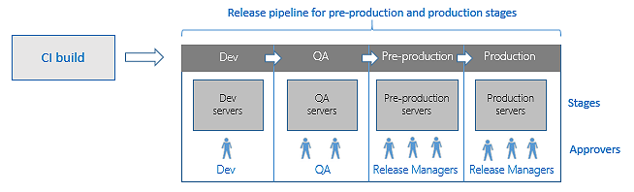
@robbymillsap
Notes:
* Here’s an example of a Pipeline

Slide 10
Pull Requests
@robbymillsap
Notes:
When I get a PR I’m looking for tests
I know it’s 2019 and I don’t have to sell
FIRST – Fast, Isolated, Repeating, Self-Validating, Timely

Slide 11
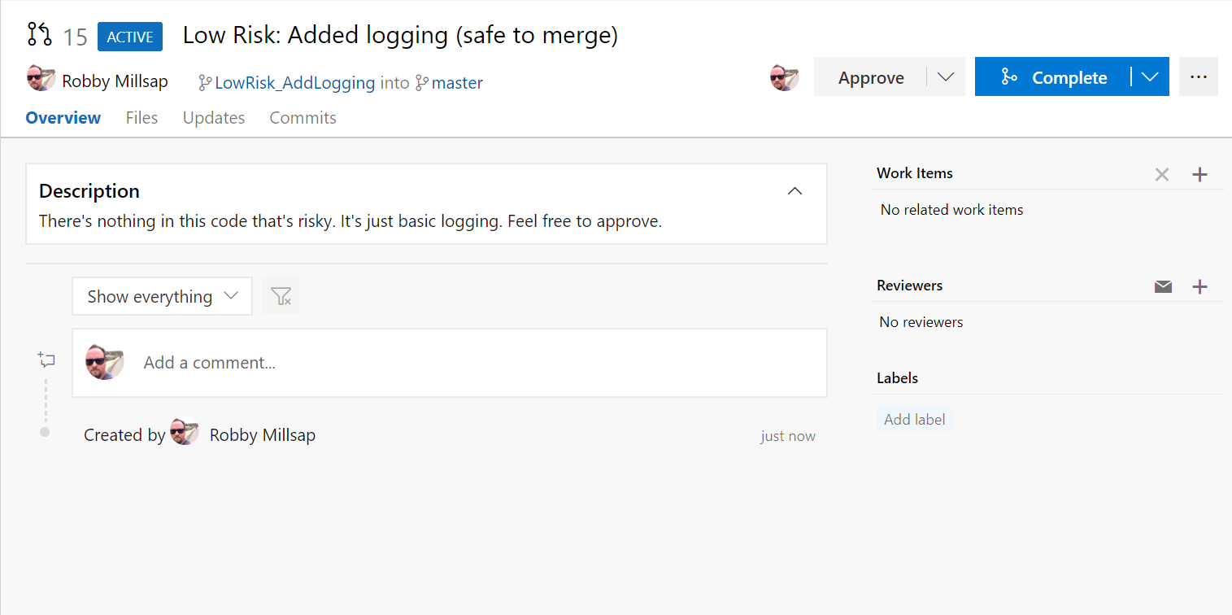
@robbymillsap
Notes:
What information can I extract from this pull request?
What is the risk level?
Is it safe to merge?

Slide 12
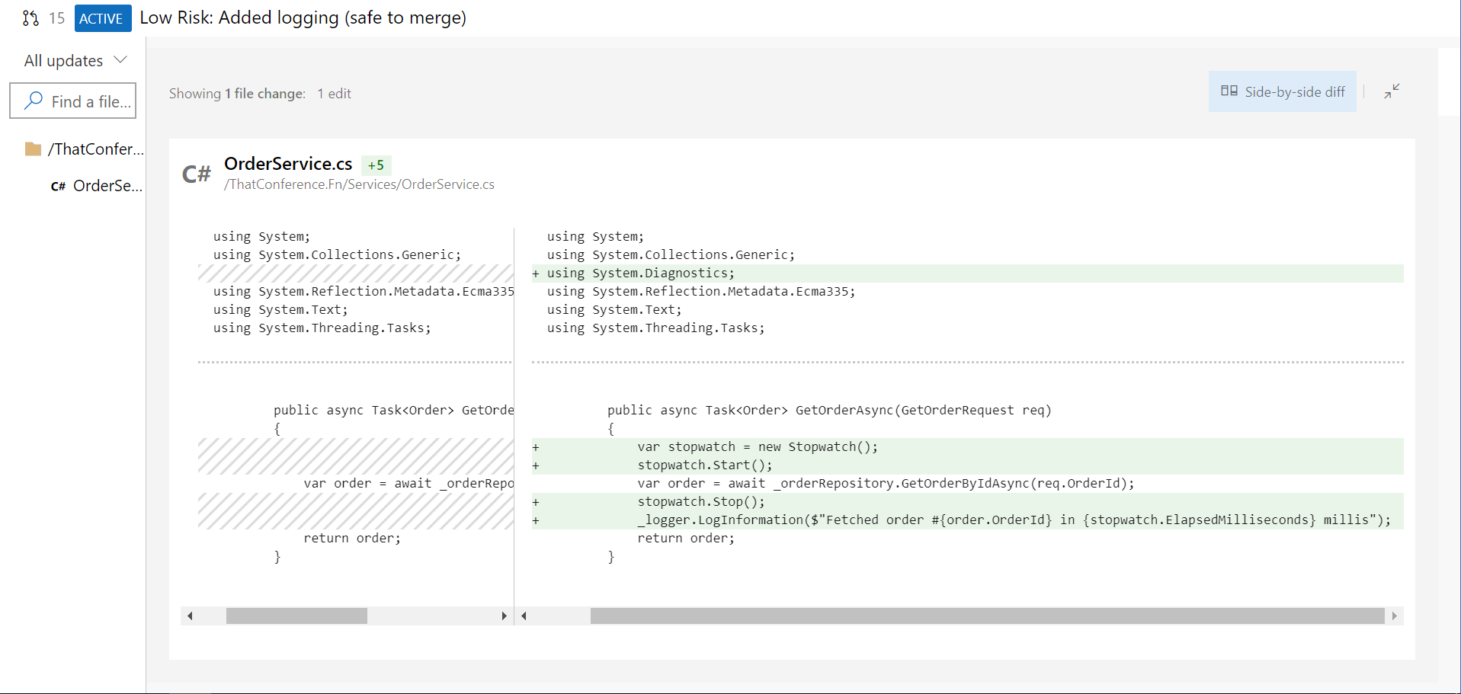
Potential null reference
@robbymillsap
Notes:
Here’s the code behind that pull request.
What can go wrong here?
Best case scenario, this might set off a bunch of exception alerts.
Worst case, maybe hit users with 500
How will this affect a SPA app?

Slide 13
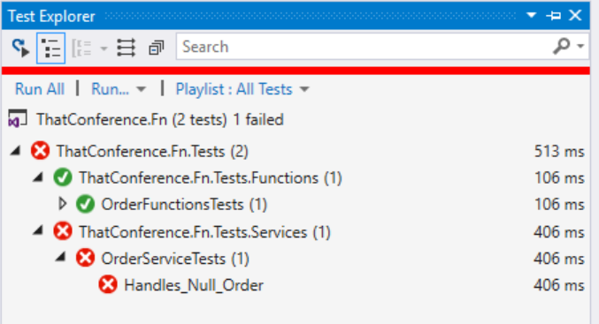
@robbymillsap
Notes:
I’ve actually got some good tests in place that should have protected me from this PR, but it was Day 4...after lunch
Should I checkout every PR and run the tests before I approve?
The sneaky developer will check it into master...

Slide 14
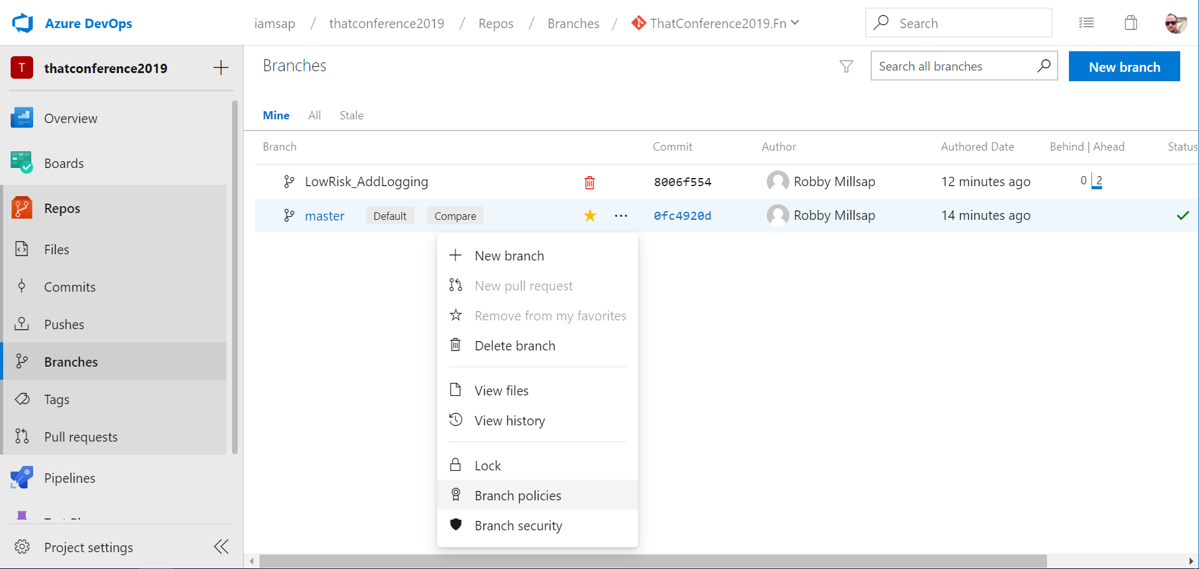
@robbymillsap
Notes:
Branch policies can be set from the Repos -> Branches...

Slide 15
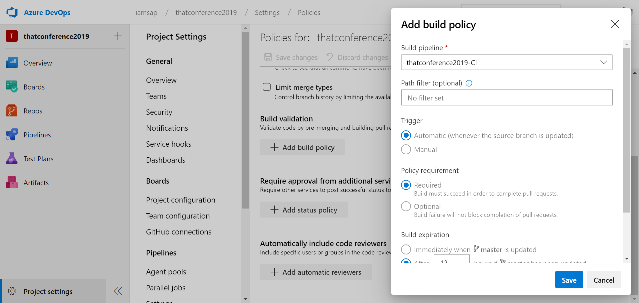
@robbymillsap
Notes:
Select the build policy
Lock down the master branch

Slide 16
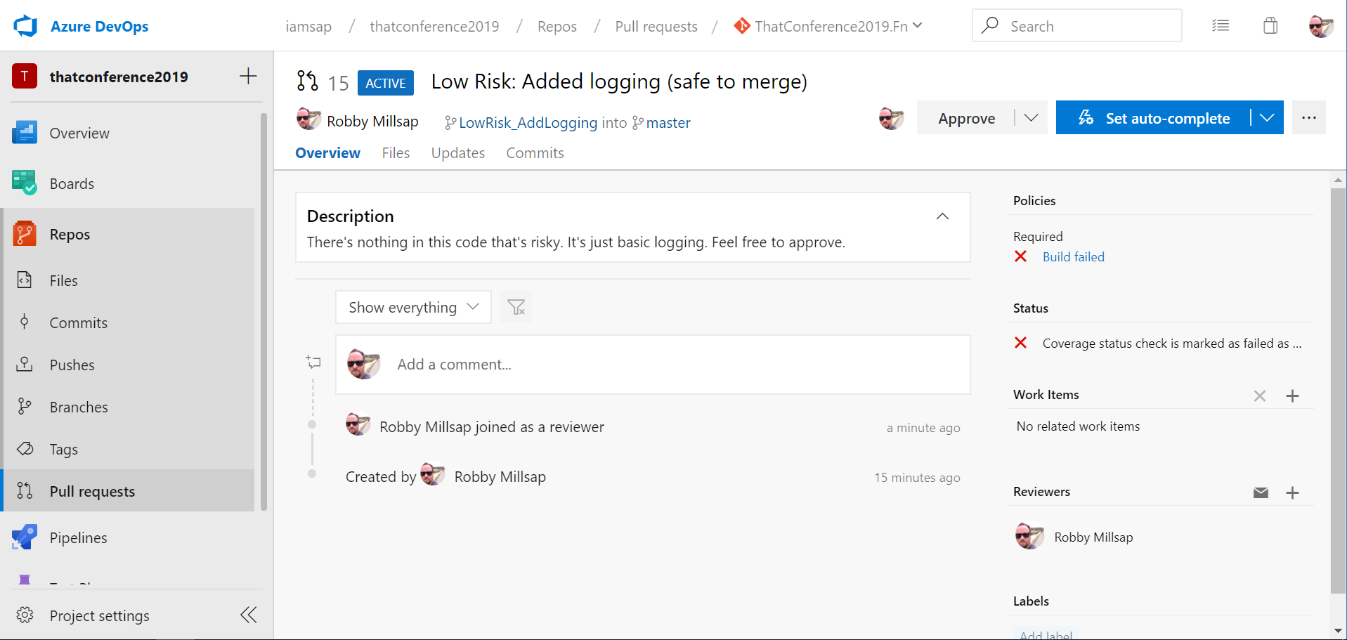
@robbymillsap
Notes:
Now look at what happens to this PR
It cannot be merged
BUT WHAT THERE’S MORE...

Slide 17
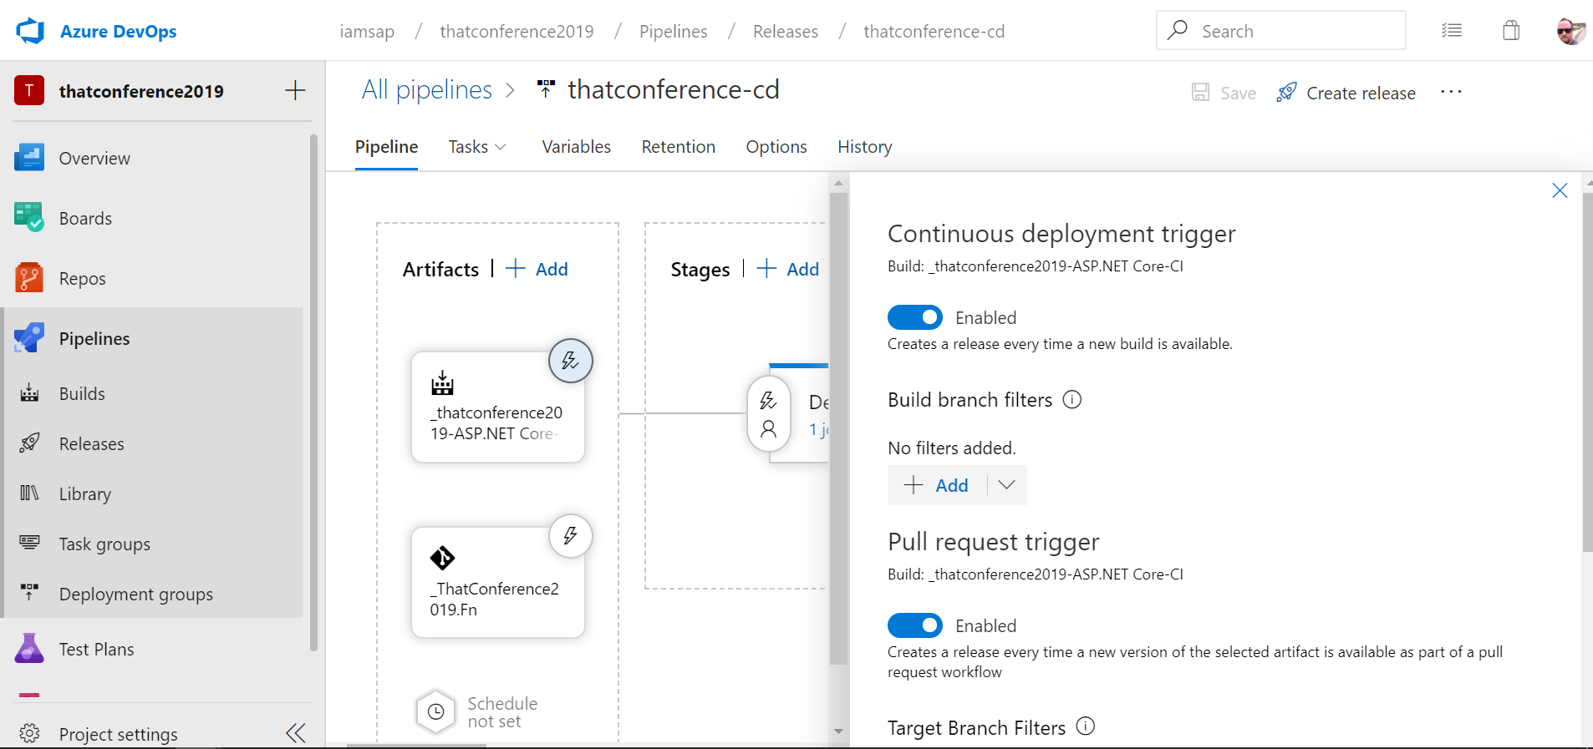
@robbymillsap
Notes:
Did you know that you can kickoff a deployment from a pull request?
Maybe you want to run some tests...

Slide 18
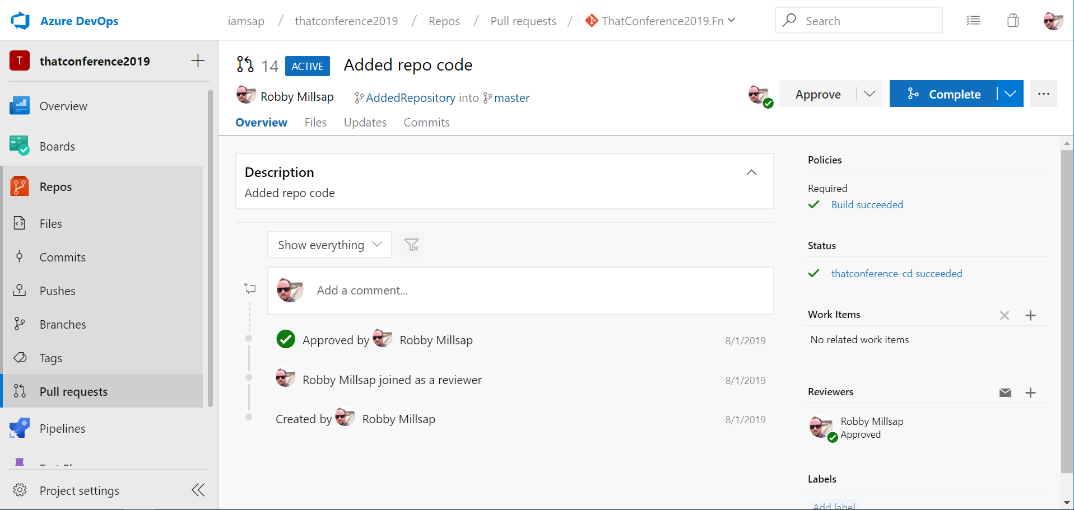
@robbymillsap
Notes:
* This PR passed the release

Slide 19
Trigger builds from pull requests
Protect master branch
(optional) Trigger CD pipeline from pull requests
@robbymillsap

Slide 20
Smoke
@robbymillsap
Notes:
* In your own words...what is a smoke test?

Slide 21
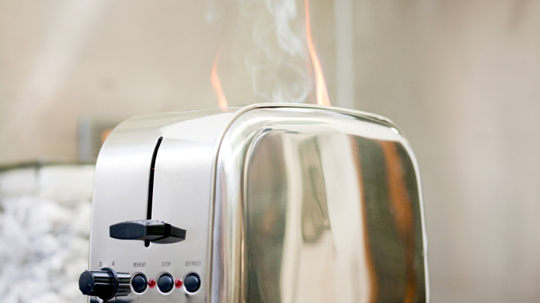
System anomaly detected
@robbymillsap
Notes:
How you test a toaster! If you plug it in and there’s no smoke...
A smoke test lets us know if things are generally OK
Non-exhaustive testing
What kind of things might we want to smoke test?

Slide 22
Availability
Health
Security
@robbymillsap
Notes:
Things you can smoke
Here’s a pet peeve of mine

Slide 23

Live DEMO!
@robbymillsap
Notes:
* Let’s look

Slide 24
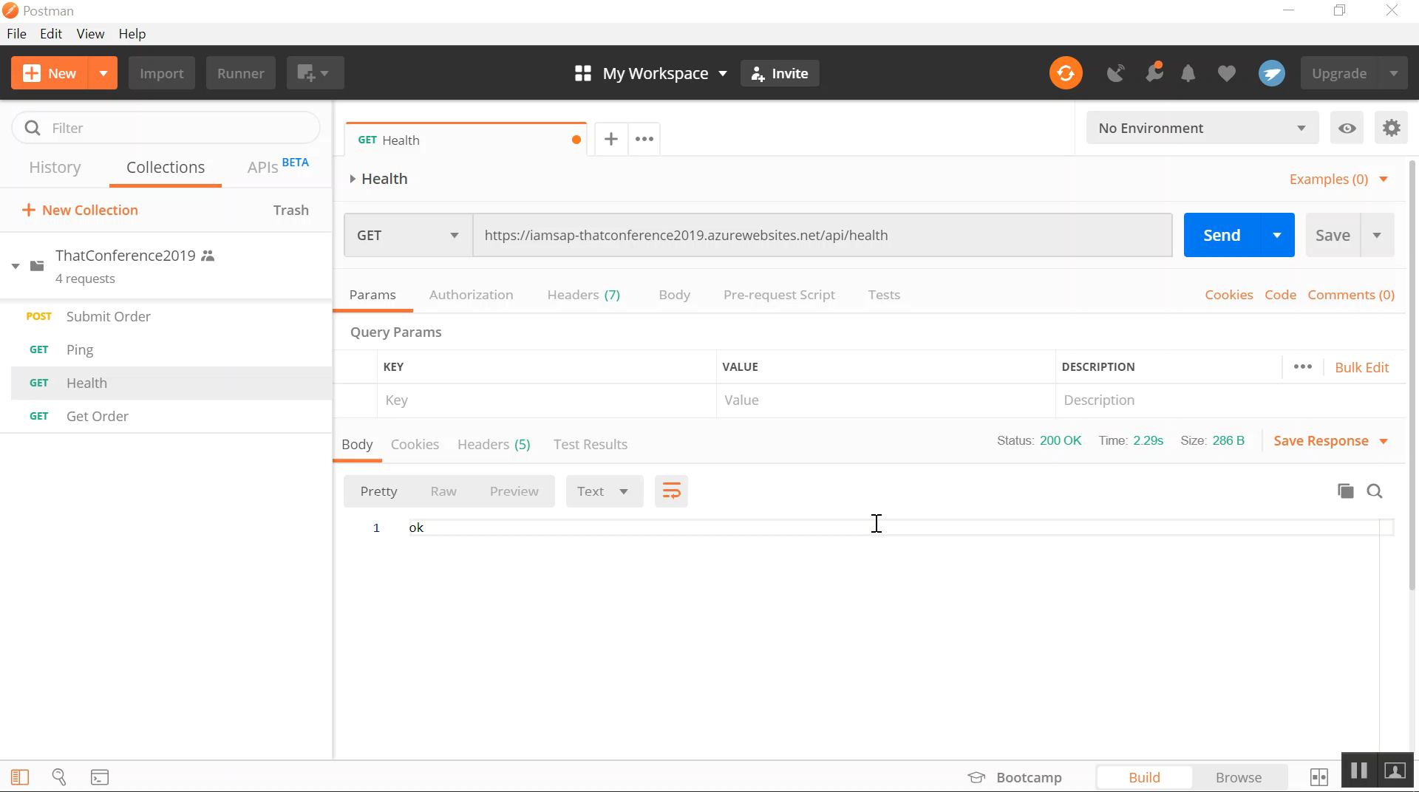

Slide 25
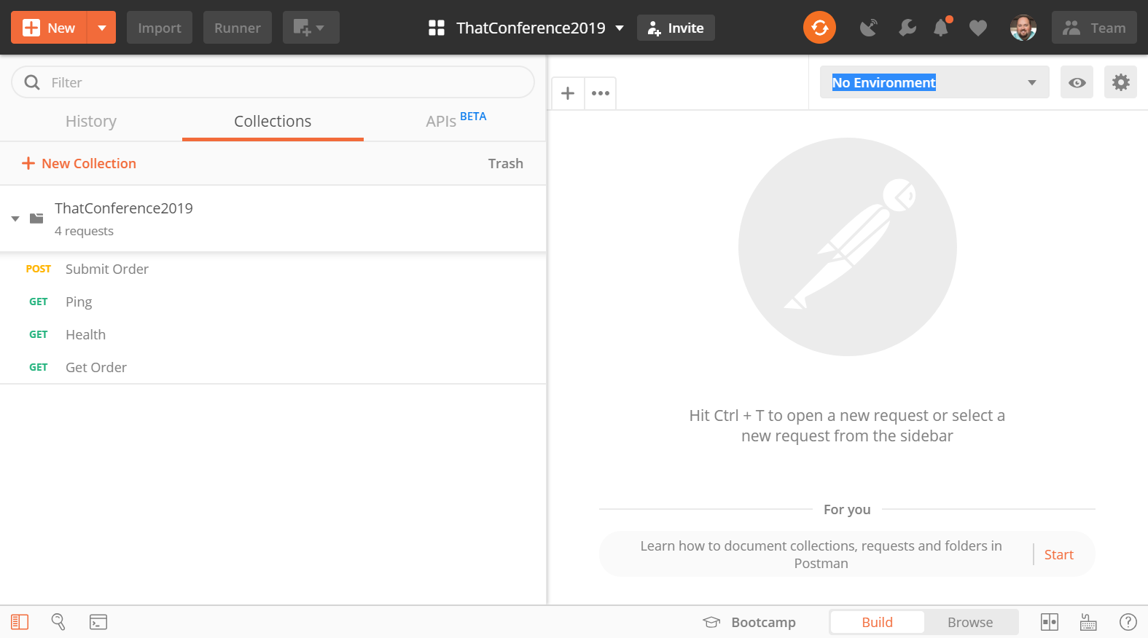
@robbymillsap
Notes:
* Which tests do you think..

Slide 26
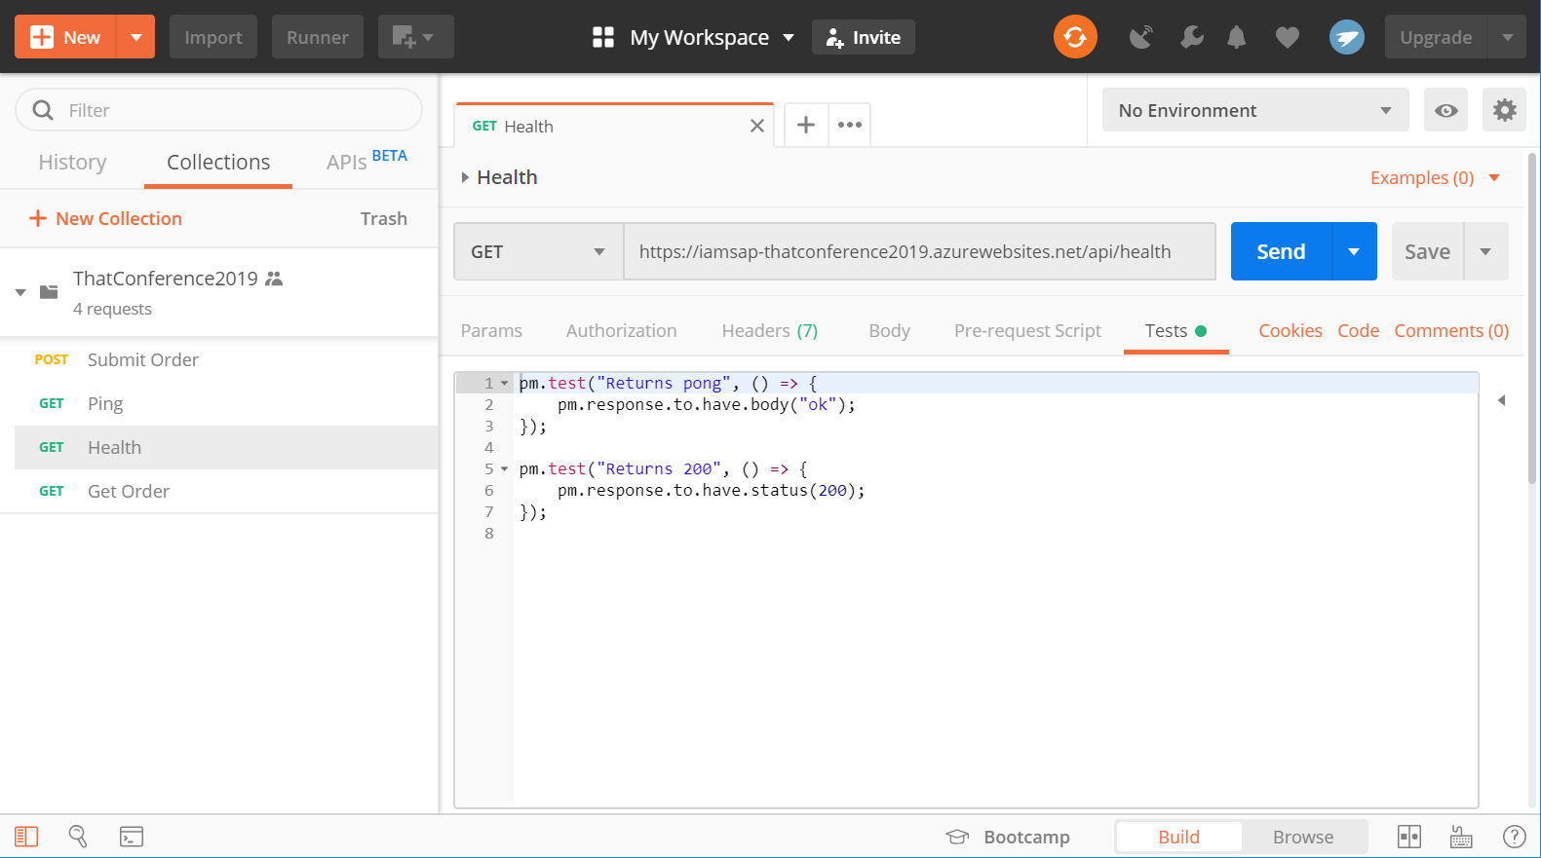
@robbymillsap
Notes:
pm.test("Returns 401 if no credentials", () => { pm.response.to.have.status(401);});

Slide 27
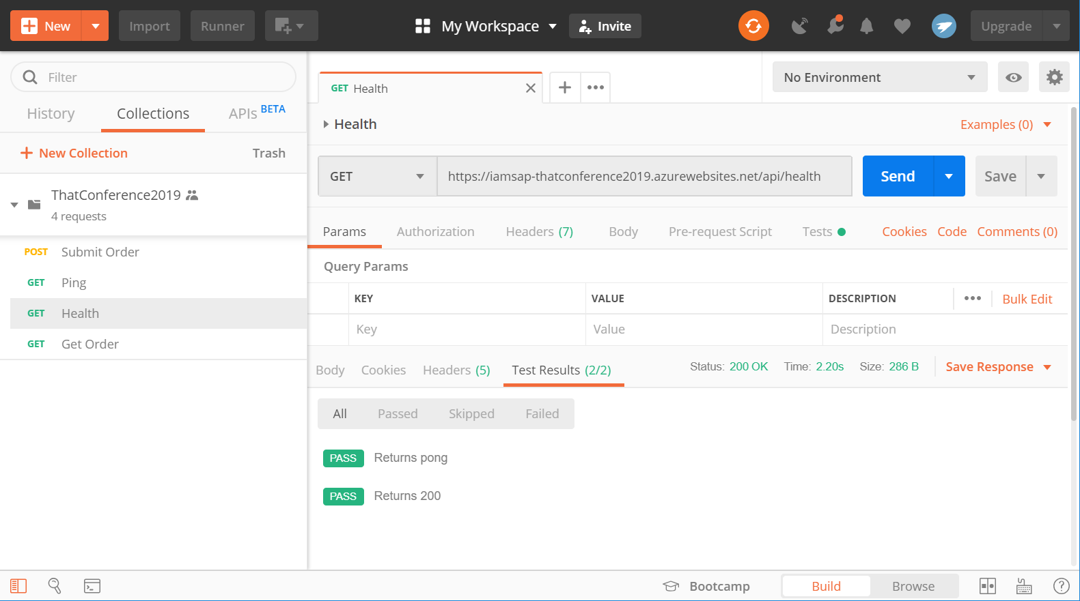

Slide 28
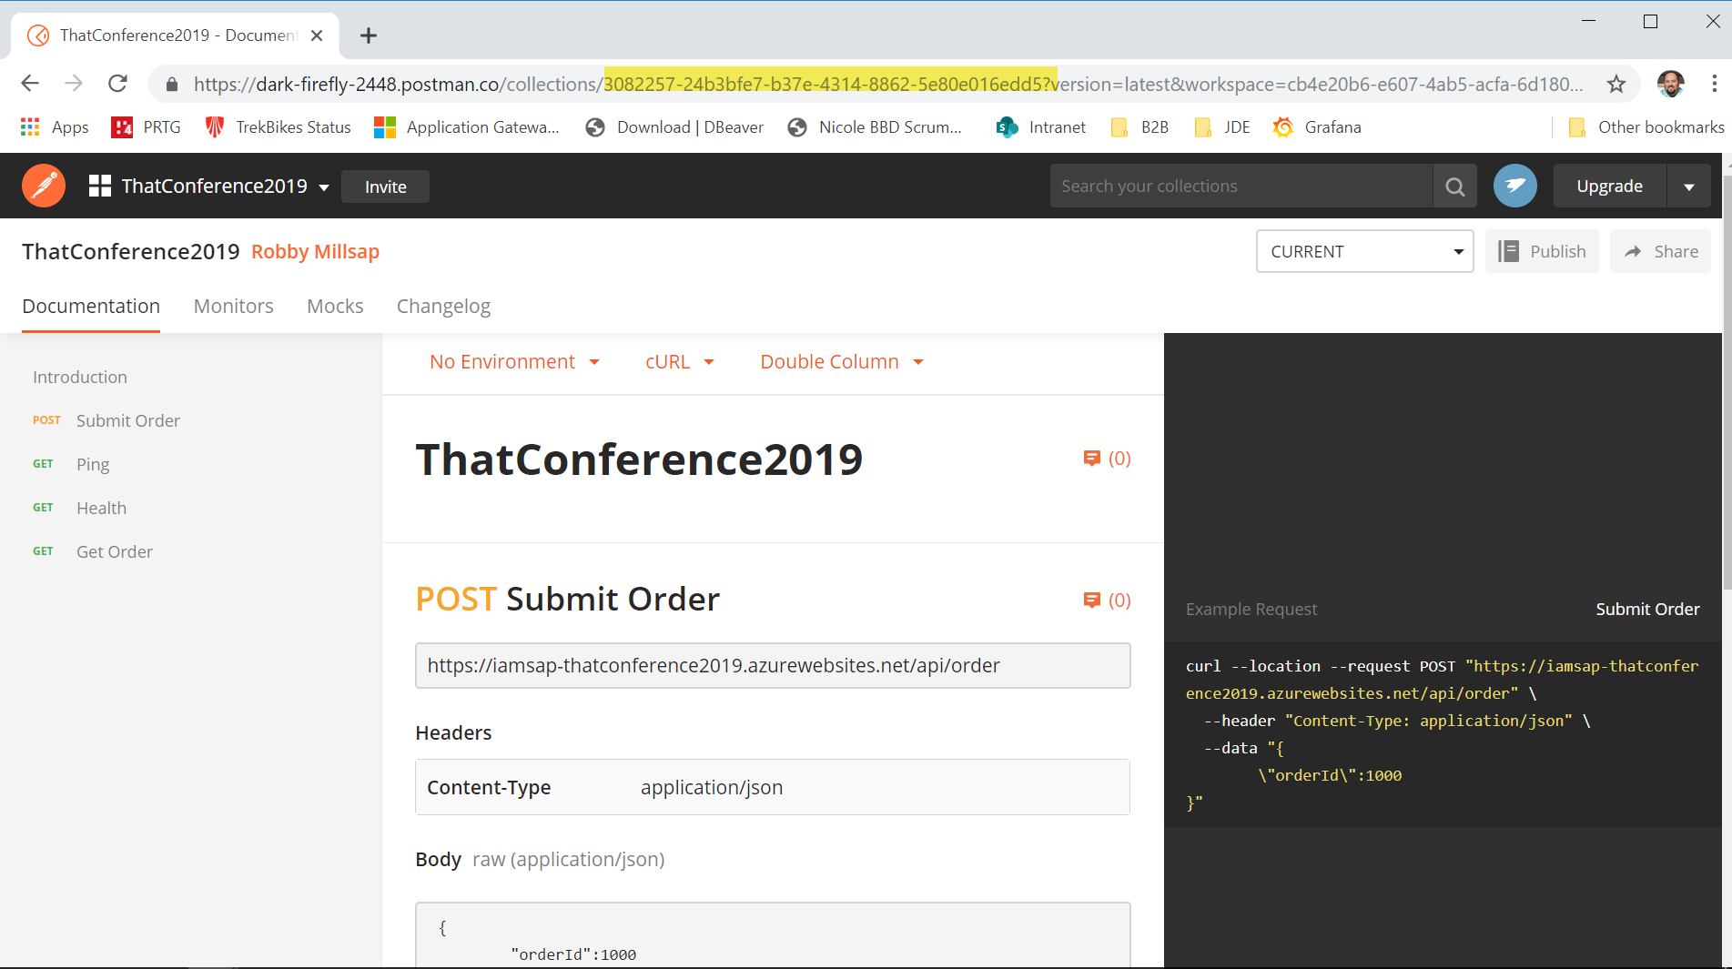
@robbymillsap

Slide 29
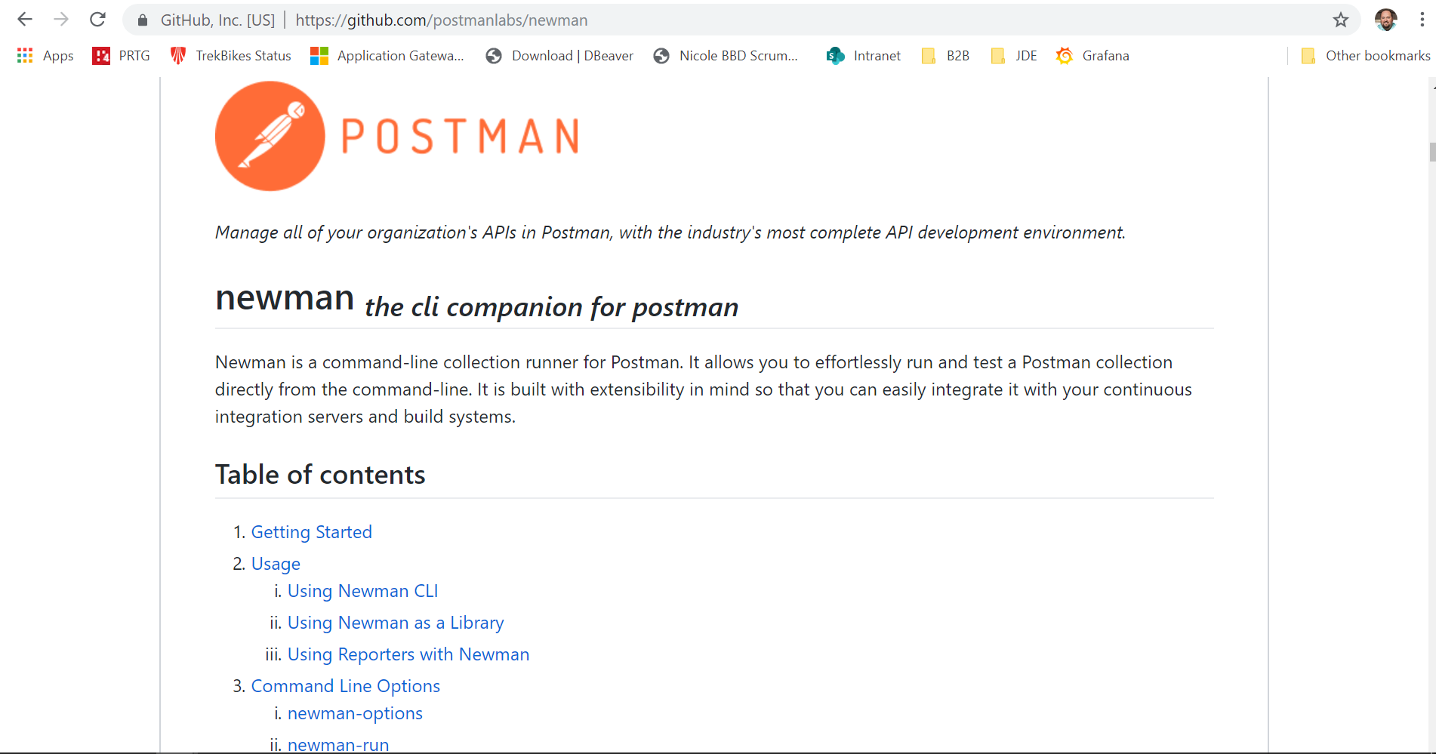
@robbymillsap
Notes:
newman run https://api.getpostman.com/collections/3082257-24b3bfe7-b37e-4314-8862-5e80e016edd5?apikey=86409c806ad743de9bdf1b5ee0f95b85

Slide 30

DEMO!
@robbymillsap
Notes:
Let’s add a smoke test stage to our build process

Slide 31
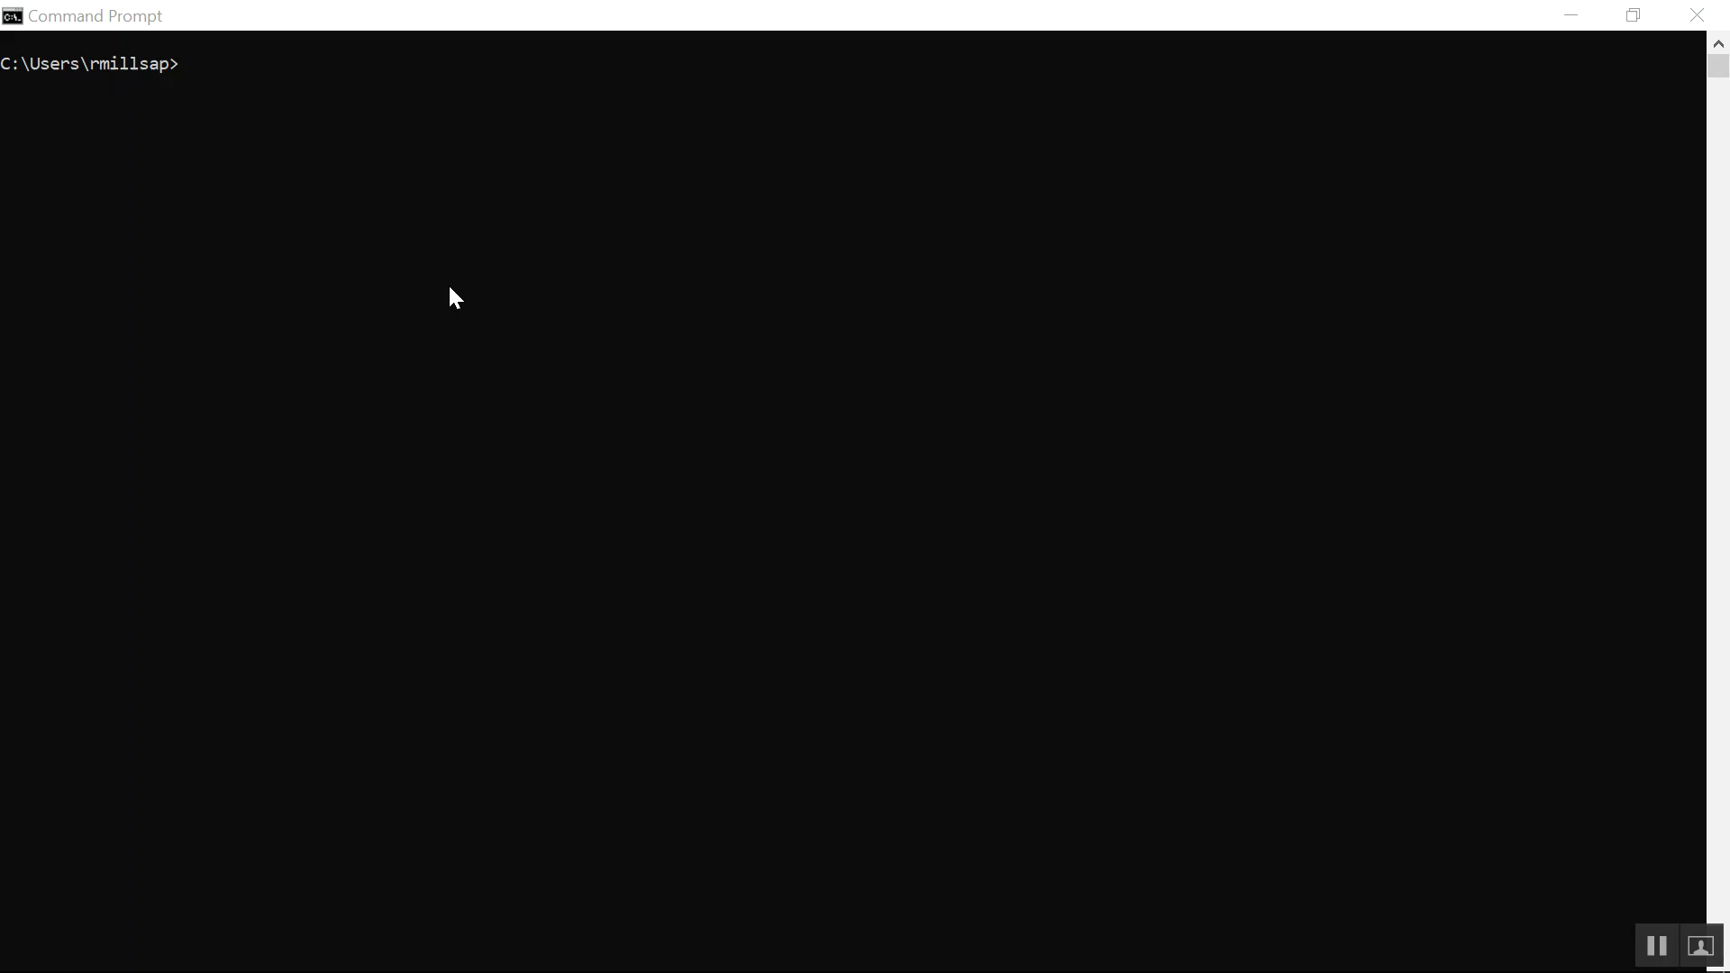
@robbymillsap

Slide 32
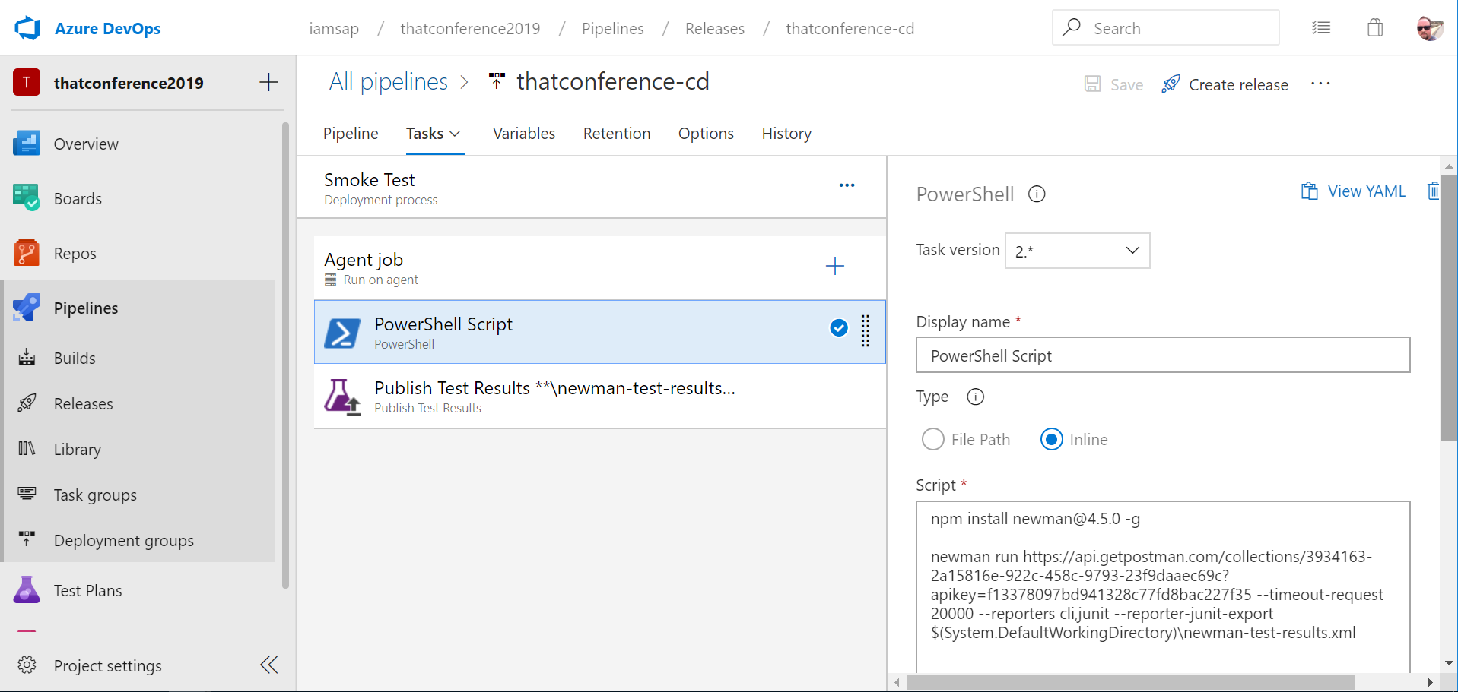
@robbymillsap
Notes:
npm install newman@4.5.0 -g
newman run https://api.getpostman.com/collections/3082257-24b3bfe7-b37e-4314-8862-5e80e016edd5?apikey=86409c806ad743de9bdf1b5ee0f95b85
--timeout-request 20000 --reporters cli,junit --reporter-junit-export $(System.DefaultWorkingDirectory)\newman-test-results.xml

Slide 33
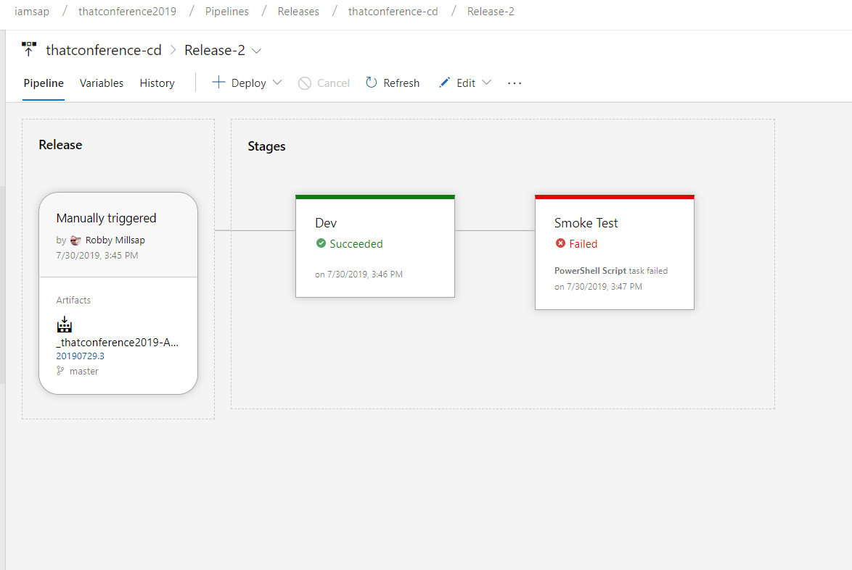
@robbymillsap

Slide 34
Smoke your deployments
Don’t make customers do it
@robbymillsap

Slide 35
Load
@robbymillsap
Notes:
* Let’s look at a system under load

Slide 36
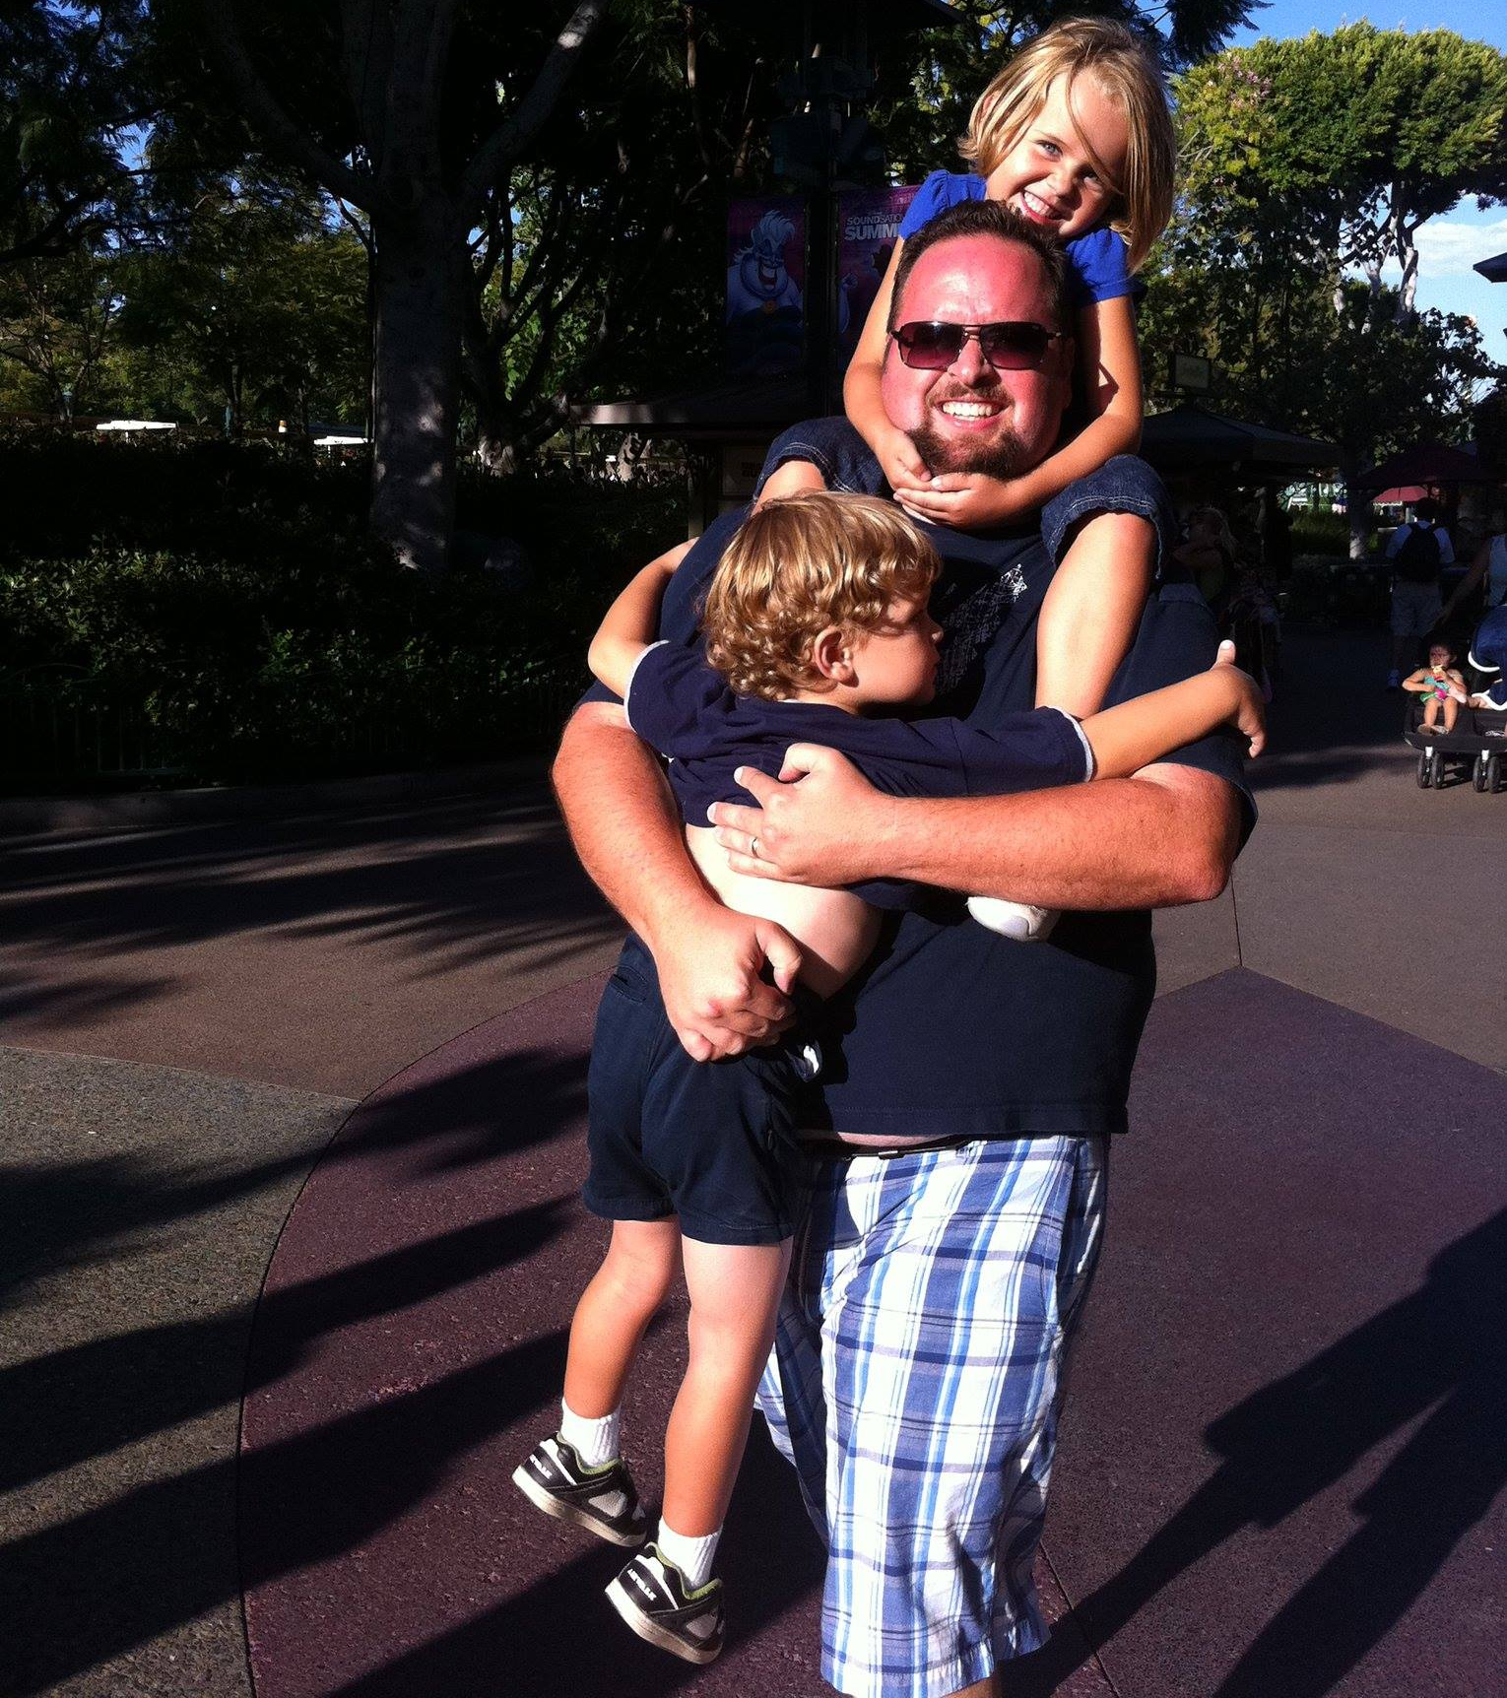
System error imminent
@robbymillsap
Notes:
Two users on this system
How long until crash?
What could have been done to prevent?

Slide 37

Live demo!
@robbymillsap
Notes:
* Let’s look at how

Slide 38
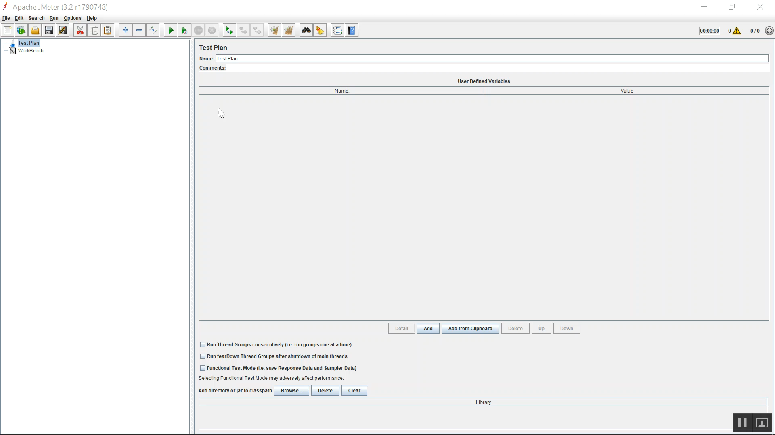

Slide 39
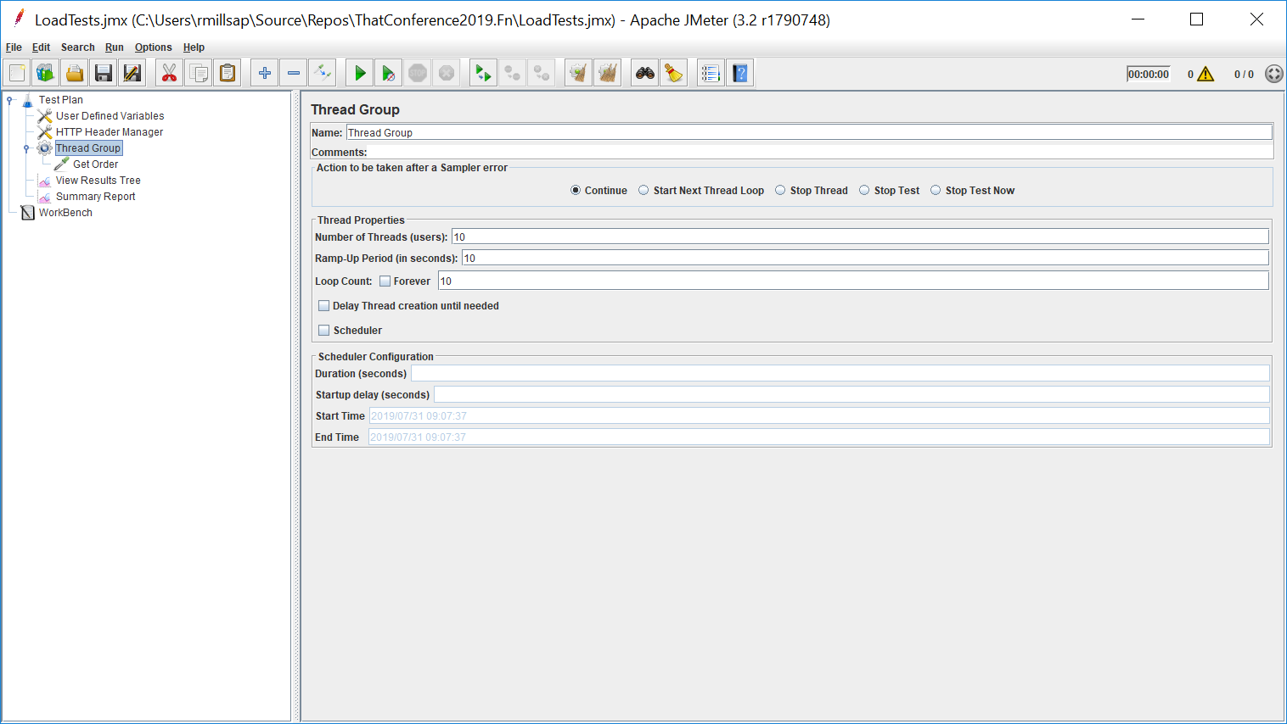
@robbymillsap
Notes:
* Jmeter is a great tool for load tests

Slide 40
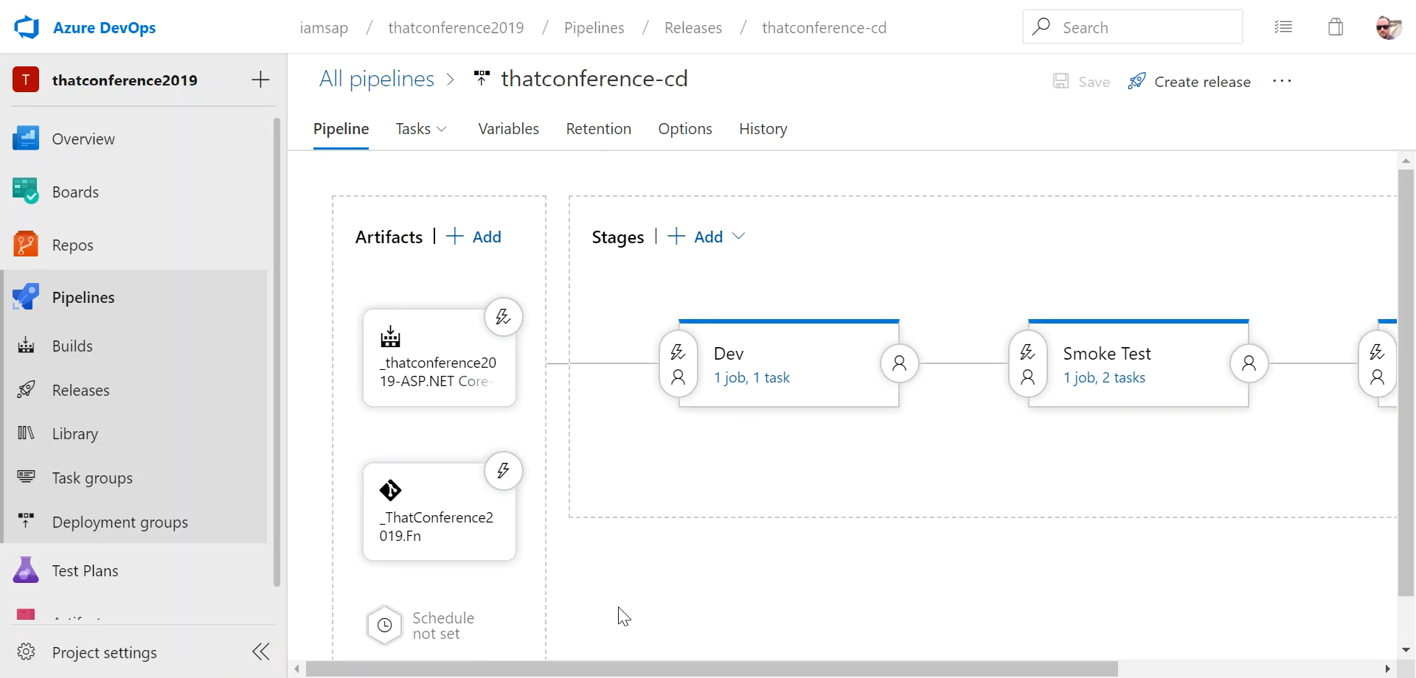
@robbymillsap

Slide 41
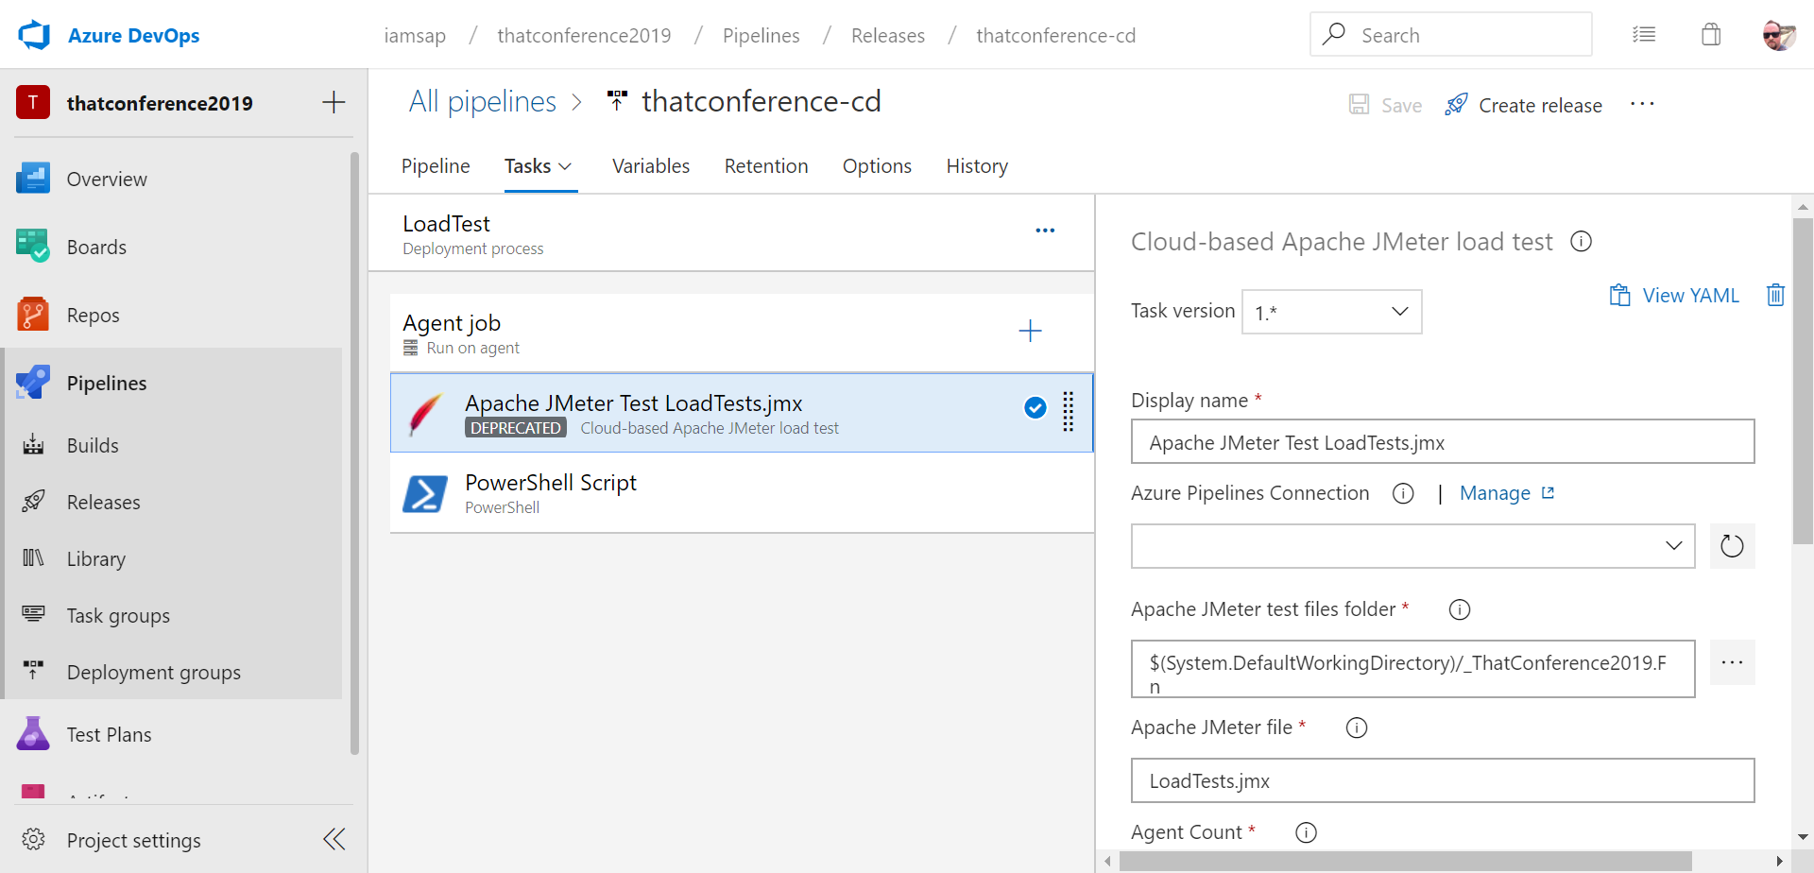
@robbymillsap

Slide 42
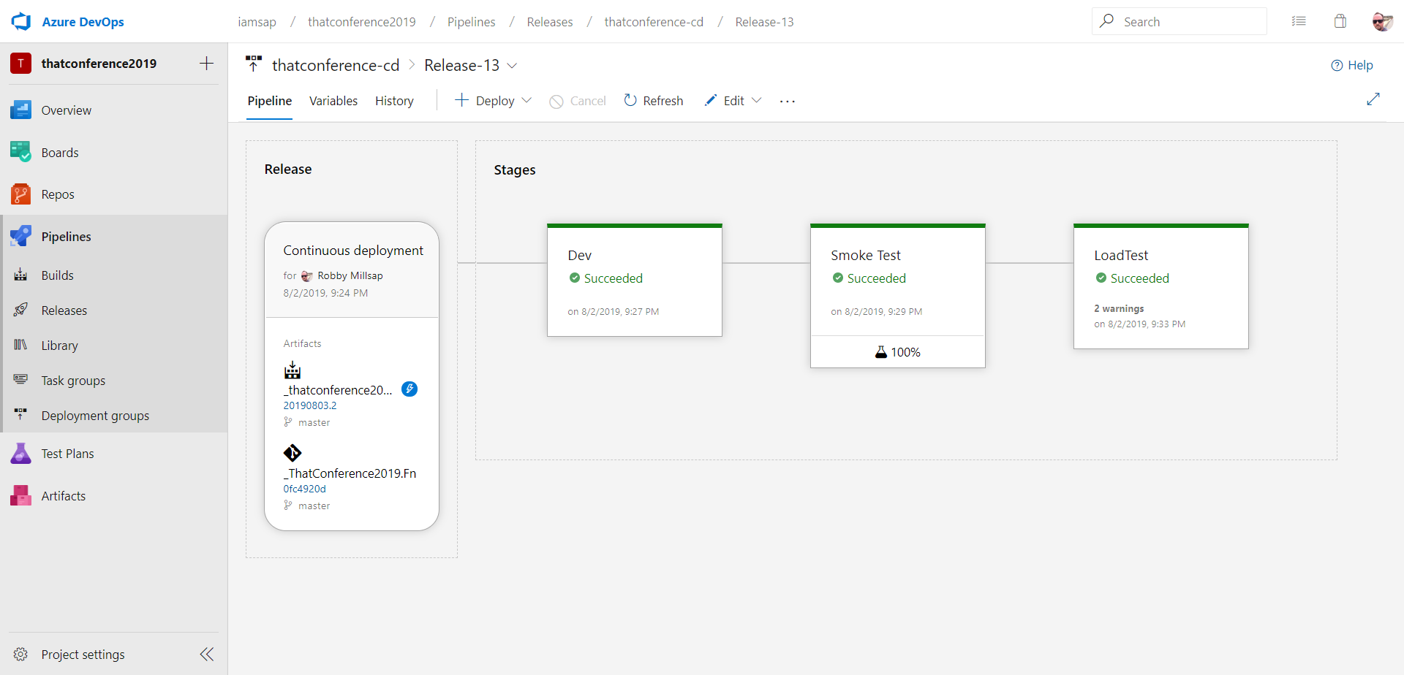
@robbymillsap

Slide 43
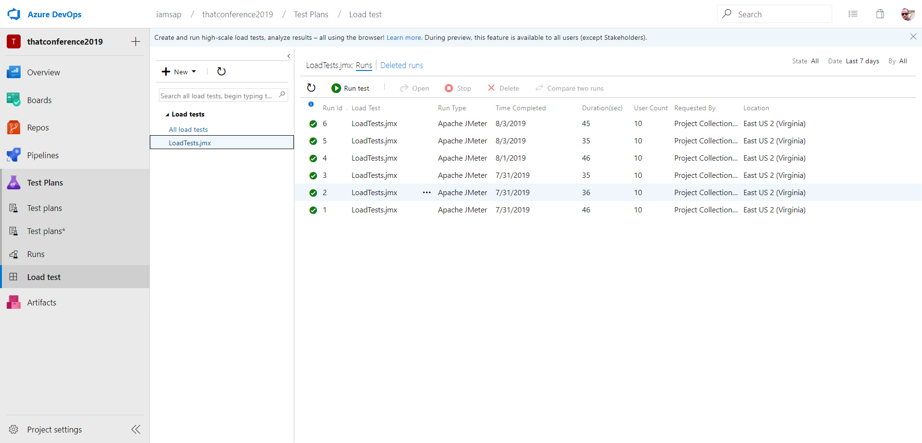
@robbymillsap

Slide 44
Measure performance
Simulate users on your system
Find breaking point
@robbymillsap

Slide 45
Prod
@robbymillsap
Notes:
how many people have code in production right now?
Is it working?
How do you know.

Slide 46
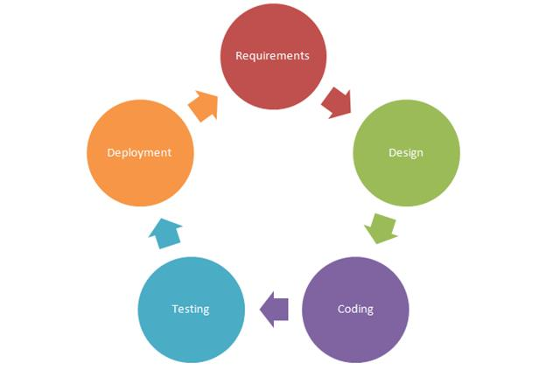
Notes:
* Who has seen a picture like this before?

Slide 47
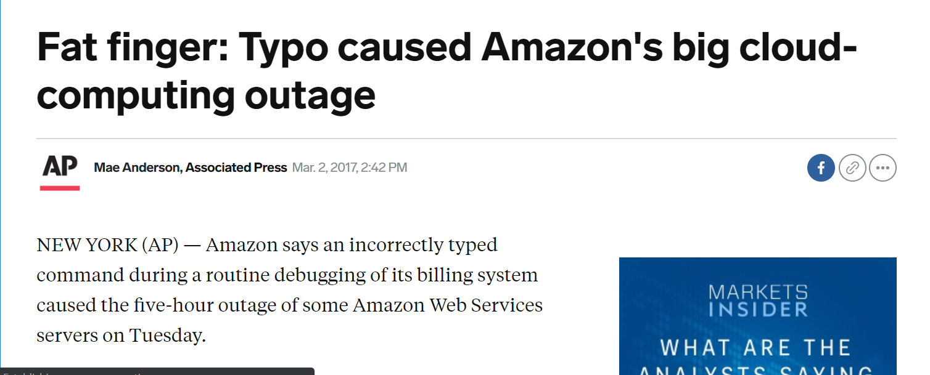
Systems go down!
@robbymillsap

Slide 48
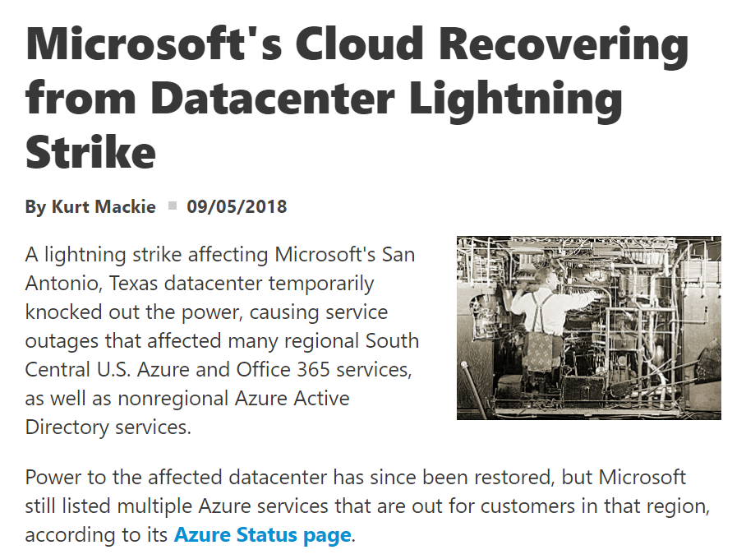
@robbymillsap

Slide 49
So what, then?
@robbymillsap
Notes:
Synthetic apps

Slide 50
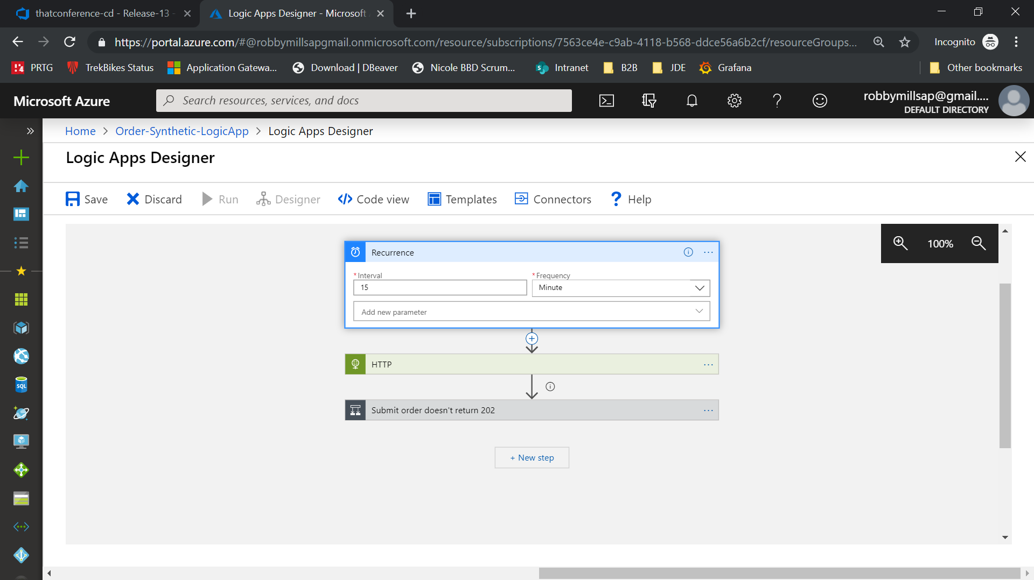
@robbymillsap

Slide 51
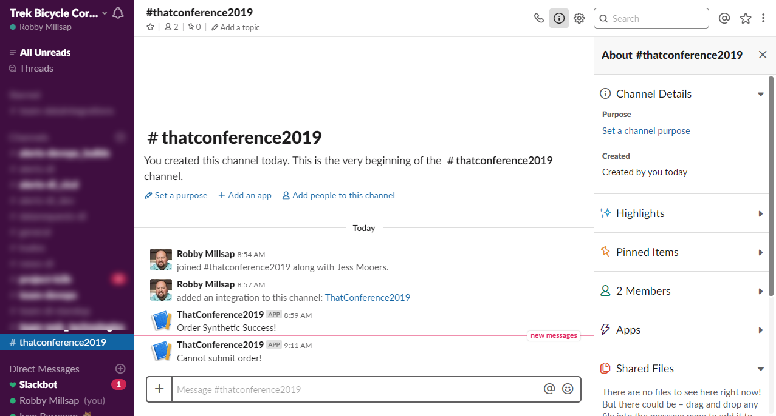
@robbymillsap

Slide 52
Automate Everything
Protect your branches with branch policies and triggers
Automate smoke tests to verify deployments
Automate load tests to protect performance
Run synthetic transactions often to monitor apps
@robbymillsap

Slide 53
Why
@robbymillsap
Notes:
Your time is valuable
Some automated tasks are better
Some human tasks are better when aided
Improve your relationships with your customers

Slide 54

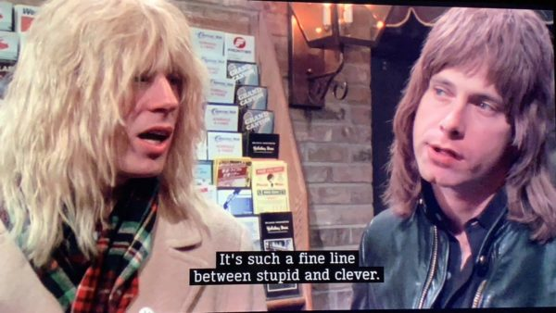
@robbymillsap

Slide 55

Stupid
Clever
Notes:
* Let me give you an example

